Slide 1
Weather Station
4B25 Embedded Systems Project

Slide 2
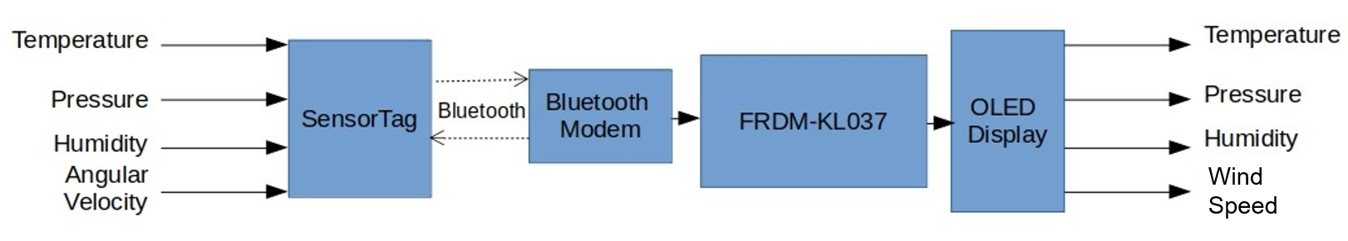
Proposed Solution
Difficulties
Demo
UART
SPI

Slide 3
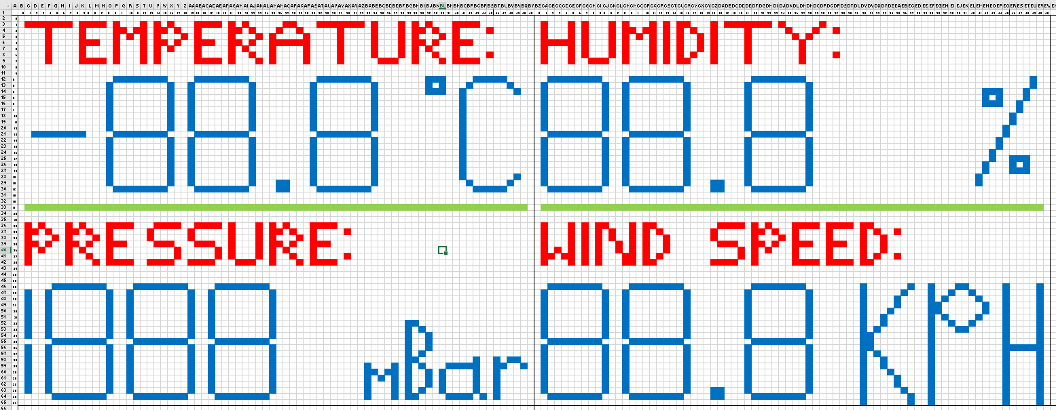
Screen Design

Slide 4
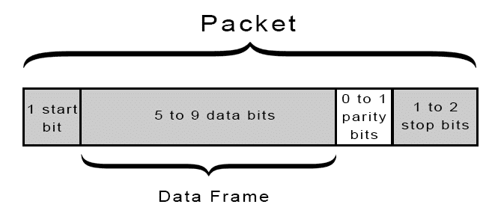
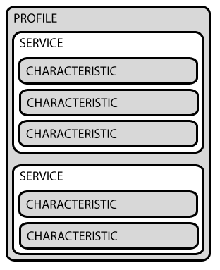
Bluetooth (The problem)
BLE Modem
Serial port profile (SPP)
‘Wireless UART’
Sensor tag
Gerneric Attributes (GATT) server/client
‘Full’ Bluetooth solution, designed for phones
Did have an SPP hex file but still couldn’t connect
Sensor tag
Temperature
Sensor
Data

Slide 5
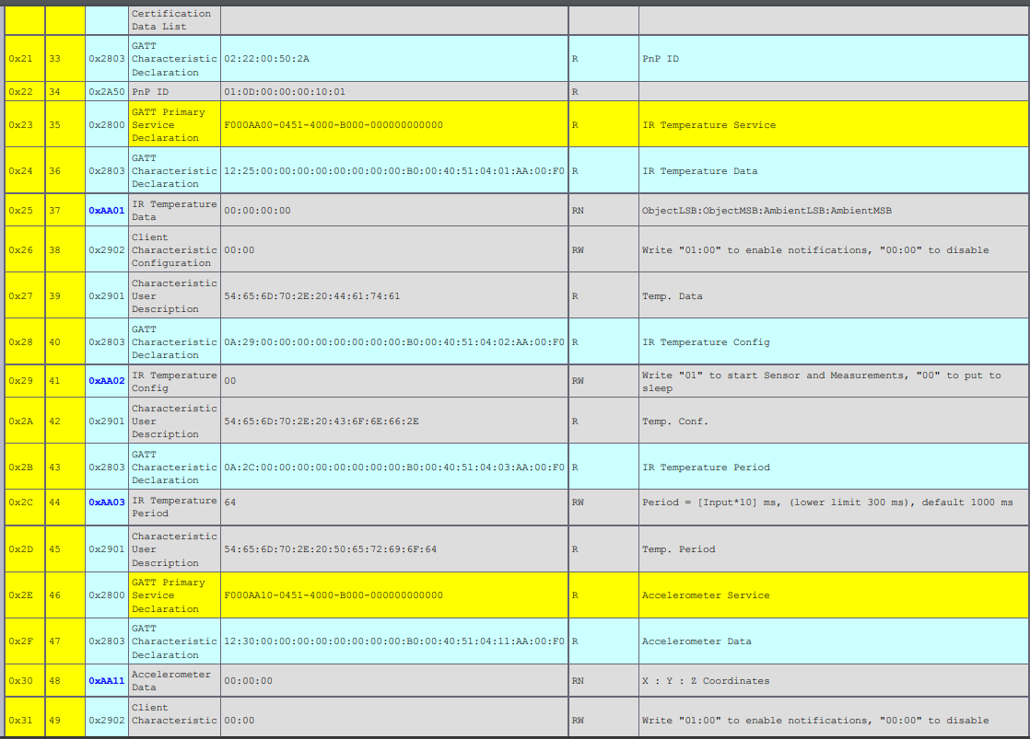
Bluetooth - GATT
C2650 GATT table

Slide 6
Lessons Learnt
Overestimate rather than underestimate time
No UART driver
Research communication protocols before purchasing
Couldn’t connect the sensortag

